Slide 1
ECE 471/571 - Lecture 19
Unsupervised Learning - Clustering
11/05/14

Slide 2
Recap
Pattern Classification
Statistical Approach
Syntactic Approach
Supervised
Unsupervised
Basic concepts:
Baysian decision rule
(MPP, LR, Discri.)
Basic concepts:
Distance
Agglomerative method
Parametric learning (ML, BL)
k-means
Non-Parametric learning (kNN)
Winner-take-all
LDF (Perceptron)
Kohonen maps
NN (BP)
Dimensionality Reduction
Fisher’s linear discriminant
K-L transform (PCA)
Performance Evaluation
ROC curve
TP, TN, FN, FP
Stochastic Methods
local optimization (GD)
Global optimization (SA, GA)

Slide 3
Unsupervised Learning
What’s unknown?
  In the training set, which class does each sample belong to?
  For the problem in general, how many classes (clusters) is appropriate?

Slide 4
Clustering Algorithm
Agglomerative clustering
  Step1: assign each data point in the training set to a separate cluster
  Step2: merge the two “closest” clusters
  Step3: repeat step2 until you get the number of clusters you want or the appropriate cluster number
The result is highly dependent on the measure of cluster distance

Slide 5
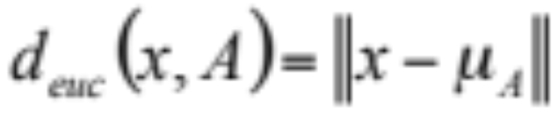
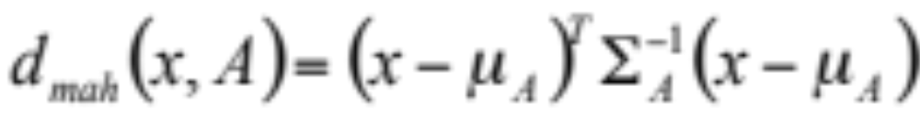
Distance from a Point to a Cluster
Euclidean distance
City block distance
Mahalanobis distance

Slide 6
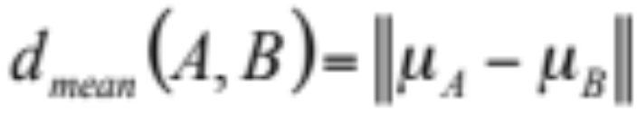
Distance between Clusters
The centroid distance
Nearest neighbor measure
Furthest neighbor measure

Slide 7
Example
dmin
dmax
C
C
B
B
A
A

Slide 8
Minimum Spanning Tree
Step1: compute all edges in the graph
Step2: sort the edges by length
Step3: beginning with the shortest edge, for each edge between nodes u and v, perform the following operations:
  Step3.1: A = find(u) (A is the cluster where u is in)
  Step3.2: B = find(v) (B is the cluster where v is in)
  Step3.3: if (A!=B) C=union(A, B), and erase sets A and B

Slide 9
Comparison of Shape of Clusters
dmin tends to choose clusters which are ??
dmax tends to choose clusters which are ??

Slide 10
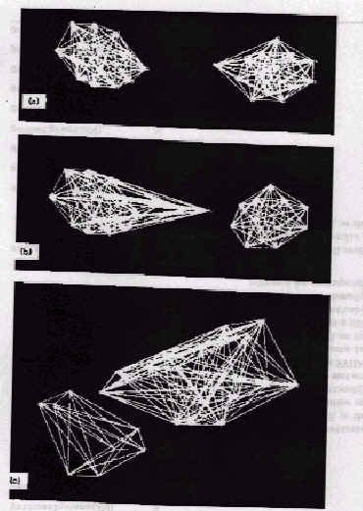
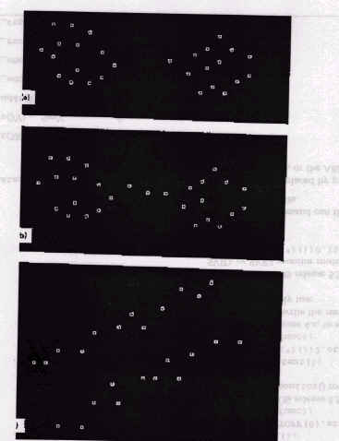
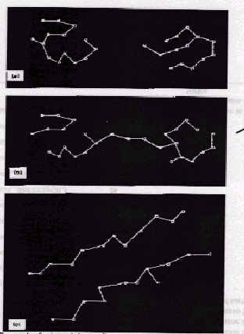
Example
Notes:
1st col: three data sets
2nd col: dmin
3rd col: dmax

Slide 11
The k-means Algorithm
Step1: Begin with an arbitrary assignment of samples to clusters or begin with an arbitrary set of cluster centers and assign samples to nearest clusters
Step2: Compute the sample mean of each cluster
Step3: Reassign each sample to the cluster with the nearest mean
Step4: If the classification of all samples has not changed, stop; else go to step 2.

Slide 12

Winner-take-all Approach
Begin with an arbitrary set of cluster centers ω_{i}
For each sample x, find the nearest cluster center ω_{α}, which is called the winner.
Modify ω_{α} using ω_{α}^{new} = ω_{α}^{old} + ε(x - ω_{α}^{old})
  ε is known as a “learning parameter”.
  Typical values of this parameter are small, on the order of 0.01.

Slide 13
Winner-take-all
x
x-ω_{α}
ω_{α}

Slide 14
Kohonen Feature Maps (NN)
An extension of the winner-take-all algorithm. Also called self-organizing feature maps
A problem-dependent topological distance is assumed to exist between each pair of the cluster centers
When the winning cluster center is updated, so are its neighbors in the sense of this topological distance.

Slide 15
SOM – A Demo
x
x-ω_{α}
ω₁
ω₄
ω_{α}
ω₂
ω₃

Slide 16
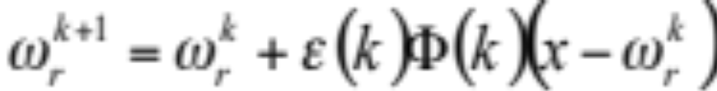

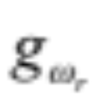
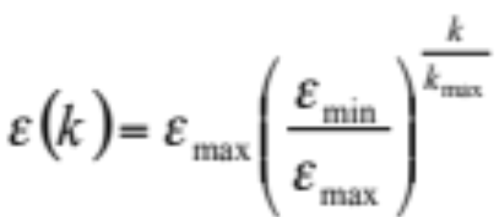
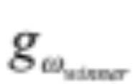
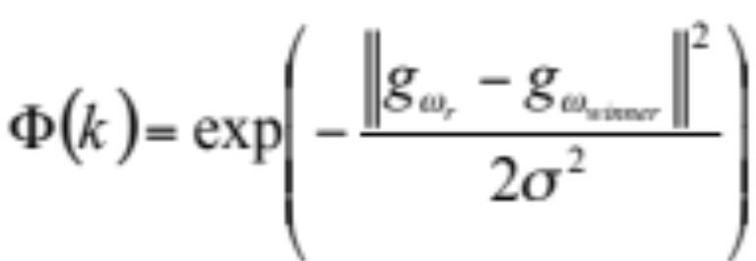
SOM – The Algorithm
The winning cluster center and its neighbors are trained based on the following formula
are the cluster centers
are the coordinate of
the cluster centers
Learning Rate
(as k inc, ε dec,
more stable)
is the coordinate of
the winner
The closer (topological closeness) the
neighbor, the more
it will be affected.

Slide 17
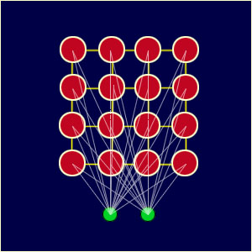
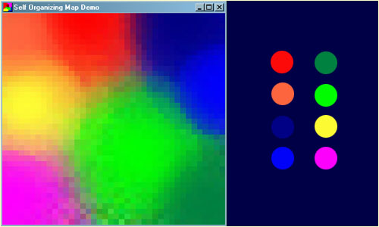
SOM - An Example
http://www.ai-junkie.com/ann/som/som1.html

